Slide 1
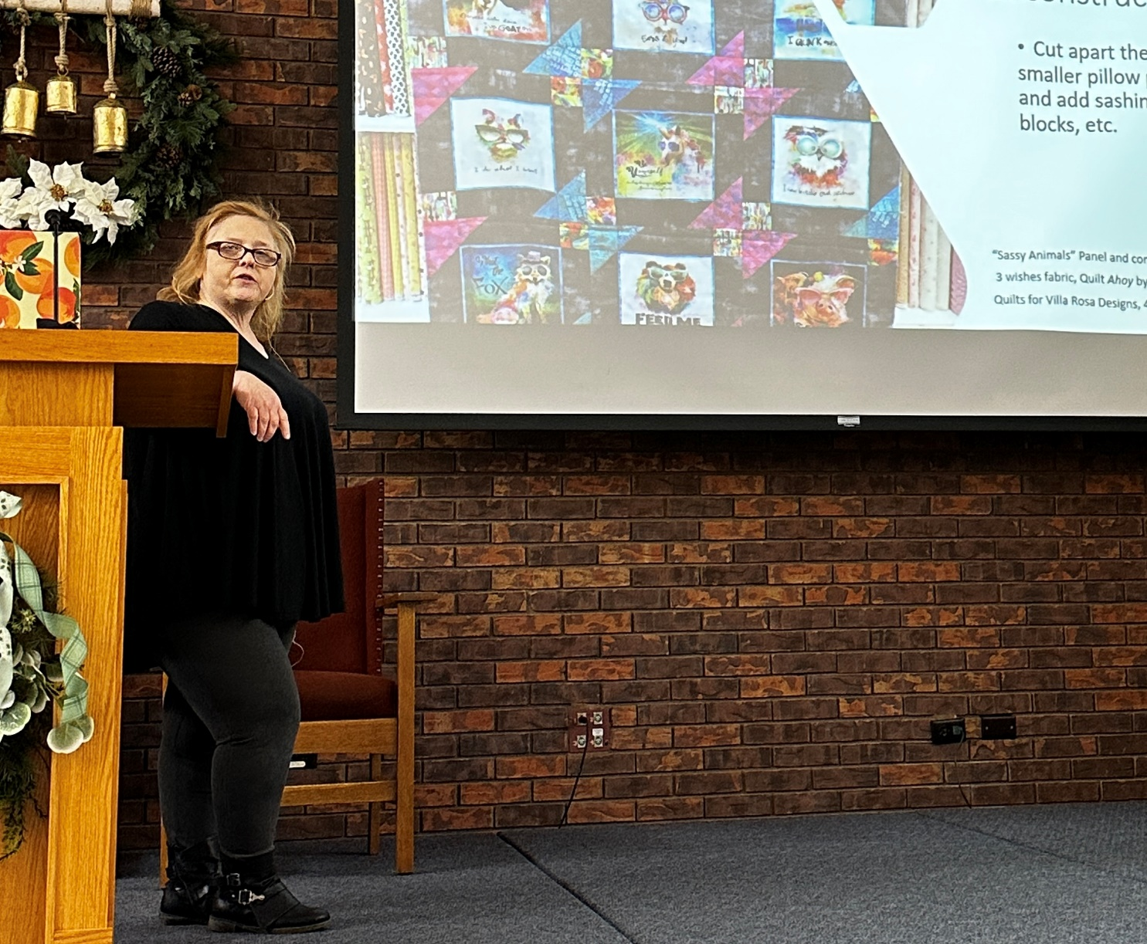
Panel Panache
Laura Strickland

Slide 2
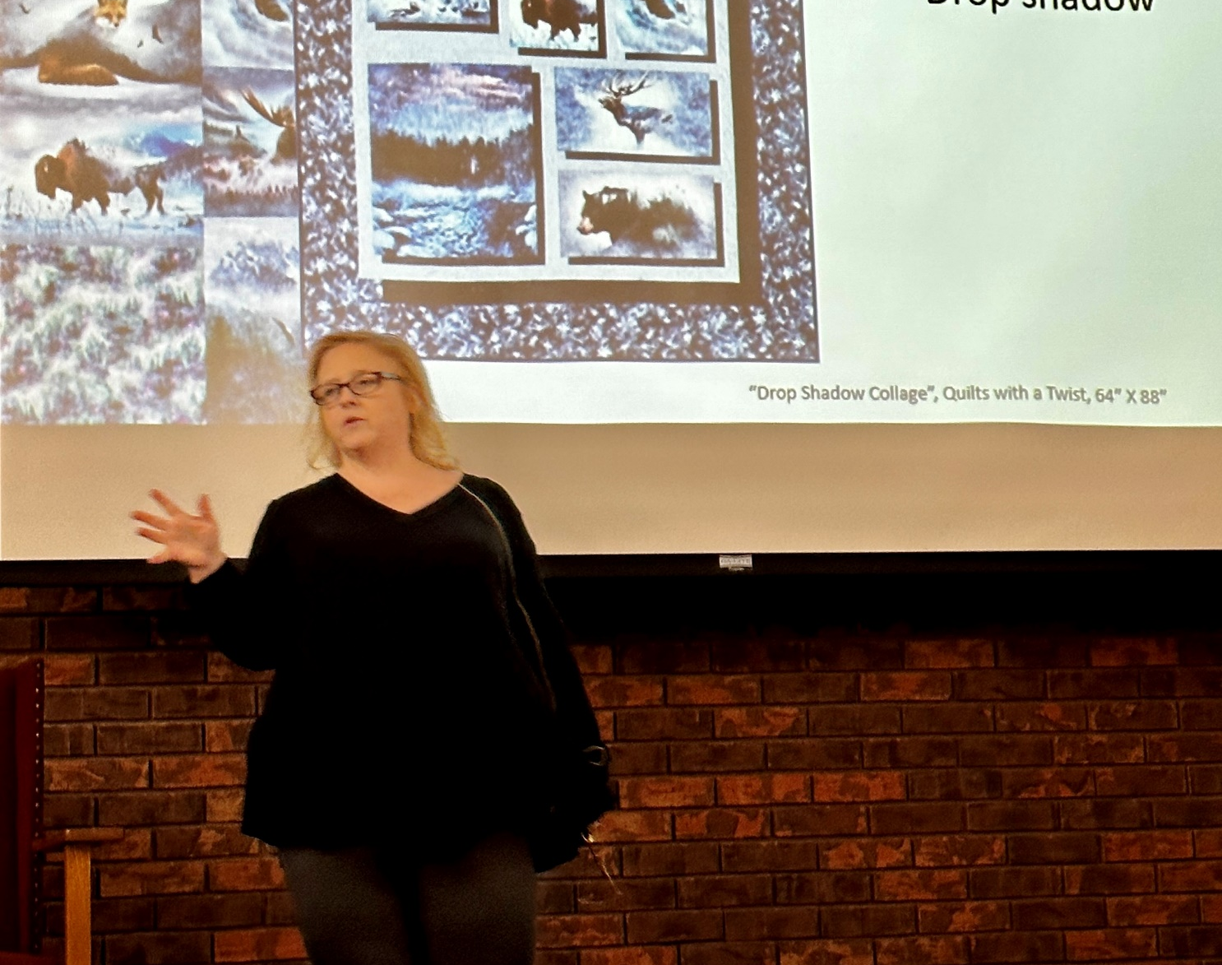
Panel Panache
Laura Strickland

Slide 3
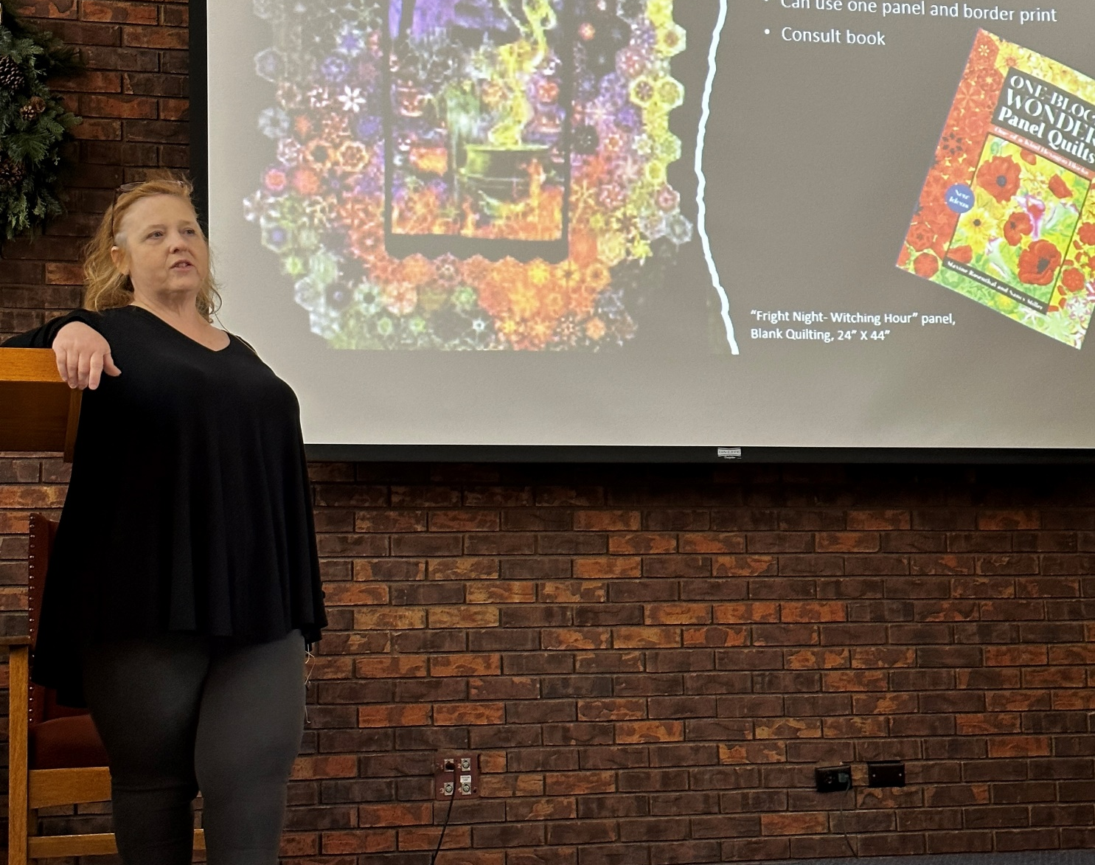
Panel Panache
Laura Strickland

